Slide 1
Breaking AES like a Bowsss
By Devolutions

Slide 2

Warning Python Ahead !
https://github.com/DoZ10/crypto
pip install requests

Slide 3

Modules
What is AES ?
Padding
Attacks and Defenses on modes of operation
Attacker Methodology
Conclusion

Slide 4
Module 0x1
What is AES ?

Slide 5

Topics
Cryptography, definitions and rules
Inside AES
Python Cryptography
Demo 1
Exercise 1

Slide 6
Cryptography
Art of sending a message in plain sight over an untrusted channel that can be read only by intended recipients.
Recipients and sender are identified by the “secret key(s)”.
An algorithm is used to transform (encrypt) a message in such way that an adversary won’t be able to recover (decrypt) its original form without having the secret key(s).
There are two types of keys: symmetric and asymmetric.
Symmetric keys are the same secrets that are shared amongst senders and recipients.
Ex. AES, 3DES, Blowfish
Asymmetric keys are pairs of secrets where one can only encrypt and the other one can only decrypt. One of them is considered “public” and is not really secret while the other is “private” and must be kept secret.
Ex. RSA, Elliptic Curves
Not covered in this workshop

Slide 7
Definitions
Plaintext
Cryptosystem
Algorithm(s) that actually encrypts and decrypts.
Plaintext
It is the message to be encrypted.
Key
It is the secret used to protect the plaintext from adversaries.
Ciphertext
It is the encrypted form of the plaintext unique to the key.
Cryptosystem or cryptographic primitive
Key
Ciphertext

Slide 8
Some Rules for Security
Ciphertext must reveal nothing about the plaintext or the key.
Ciphertext must be unique for any given plaintext and key pair (collision-free).
Ciphertext must indistinguishable from random for any given plaintext and key pair (adversary game).

Slide 9
Advanced Encryption Standard (AES)
Advanced Encryption Standard (AES) supersedes the Data Encryption Standard (DES) in early security computing.
AES is not an algorithm, but rather a framework. The algorithm used by AES is Rijndael.
AES is a block cipher. This means that inputs and outputs have a fixed size.
There are currently two widely used flavors of AES;
AES128, key size is 128 bits.
AES256, key size is 256 bits.
Plaintext 128 bits (16 bytes)
AES128
Or
AES256
Key
128 or 256 bits
(16 or 32 bytes)
Ciphertext 128 bits (16 bytes)

Slide 10
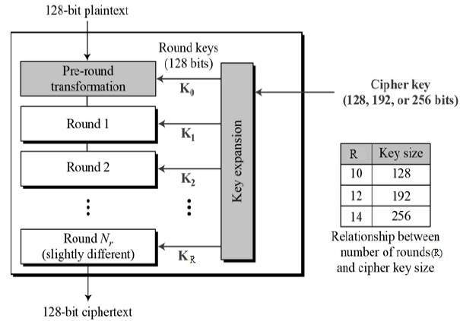
Inside AES

Slide 11
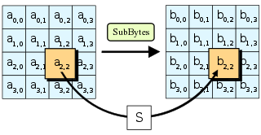
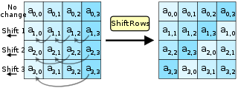
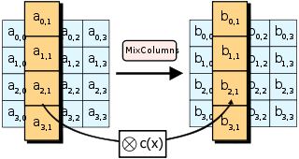
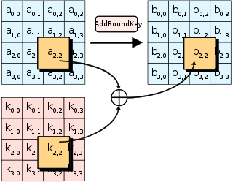

Slide 12
XOR (Exclusive-OR operation)
A | B | Result
0 | 0 | 0
0 | 1 | 1
1 | 0 | 1
1 | 1 | 0
A ^ A = 0
A ^ 0 = A
A ^ 1 = not A
A ^ A ^ B = B

Slide 13



Setup
Plaintext or ciphertext
Encrypted or decrypted result

Slide 14
Demo #1

Slide 15
Challenge #1

Slide 16
Module 0x2
Padding

Slide 17

Topics
The requirement for padding
Null or zero and PKCS7 padding standards
Attacks on padding
Challenge 2

Slide 18
Requirements of padding
Block ciphers have fixed-sized inputs.
When plaintext is bigger than 128 bits, we can add a new block.
However, that new block must also fit on a 128-bit block size.
Problem is that plaintext rarely fit to a fixed 128-bit size block.
P
L
A
I
N
T
E
X
T
N
O
T
F
I
T
T
I
N
G
AES
AES
x
Error, plaintext not aligned to block size.
CIPHERTEXT

Slide 19
Null or zero padding
ENCRYPT
DECRYPT
P
L
A
I
N
T
E
X
T
N
O
T
F
I
T
T
I
N
G
0
0
0
0
0
0
0
0
0
0
0
CIPHERTEXT
CIPHERTEXT
AES
AES
AES
AES
CIPHERTEXT
CIPHERTEXT
P
L
A
I
N
T
E
X
T
N
O
T
F
I
T
T
I
N
G
0
0
0
0
0
0
0
0
0
0
0
PLAINTEXT NOT FITTING

Slide 20
Attacks on Null or zero padding
TAMPER CIPHERTEXT !
CIPHERTEXT
MODIFIED CIPHERTEXT
AES
AES
P
L
A
I
N
T
E
X
T
N
O
T
F
I
1
3
H
@
.
2
0
0
!
Z
b
,
u
F
/
0
PLAINTEXT NOT FI13H@.200!Zb,uF/
1 out of 256

Slide 21
PKCS7 Padding
Good padding
P
L
A
I
N
T
E
X
T
N
O
T
F
I
T
T
I
N
G
0x0B
0x0B
0x0B
0x0B
0x0B
0x0B
0x0B
0x0B
0x0B
0x0B
0x0B
P
L
A
I
N
T
E
X
T
N
O
T
F
I
T
T
I
N
G
!
!
!
0x07
0x07
0x07
0x07
0x07
0x07
0x07
P
L
A
I
N
T
E
X
T
N
O
T
F
I
T
T
I
N
G
A
T
A
L
L
0x04
0x04
0x04
0x04
Bad padding
P
L
A
I
N
T
E
X
T
N
O
T
F
I
T
T
I
N
G
A
T
A
L
L
0x04
0x04
0x04
0x0A
P
L
A
I
N
T
E
X
T
N
O
T
F
I
T
T
I
N
G
A
T
A
L
L
0x04
0x0A
0x04
0x04

Slide 22
Attacks on PKCS7 padding
TAMPER CIPHERTEXT !
Ciphertext
Modified Ciphertext
AES
AES
P
L
A
I
N
T
E
X
T
N
O
T
F
I
E
%
$
2
R
0xFB
/
0x03
a
r
0xDE
0xE1
#
@
9
0x01
1 out of 256
PLAINTEXT NOT FIE%$2R\0xFB/\X03ar\0xDE\0xE1#@9

Slide 23
Challenge #2

Slide 24
Module 0x3
Attacks and Defenses on modes of operation

Slide 25

Topics
Why modes of operation?
CBC-mode
CTR-mode
Challenge 3

Slide 26
Why modes of operations ?
Modes of operation extend security beyond one block of AES
Mitigates potential attacks
Aims at maintaining performance

Slide 27
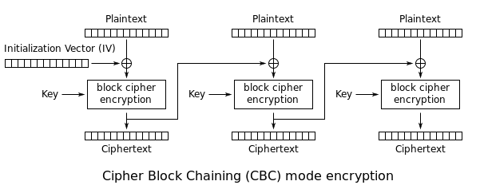
Cipher-Block-Chaining (CBC)
PKCS7 padding
Block swapping resistance
Not parallizable
Adds a IV

Slide 28
The Initialization Vector (IV)
The IV must be unique for each plaintext to encrypt.
The IV does not need to be secret, it needs to be unpredictable.
Many implementors use the IV like a key ! This means they always use the same one and hide it on server. We call this vulnerability “static IV”.

Slide 29
Plaintext Bruteforce Attack
USERNAME=MLEMAY&
ISADMIN=FALSE
Ciphertext 1
Ciphertext 2
USERNAME=MLEMAYA
AAAAAAAAAAAAAAAA
&ISADMIN=FALSE
Ciphertext 1
Ciphertext 2
Ciphertext 3
USERNAME=MLEMAYA
AAAAAAAAAAAAAAA&
ISADMIN=FALSE
Ciphertext 1
Ciphertext 2 (save me!)
Ciphertext 3
Character to bruteforce

Slide 30
Plaintext Bruteforce Attack
USERNAME=MLEMAYA
AAAAAAAAAAAAAAA&
ISADMIN=FALSE
Ciphertext 1
Ciphertext 2 (save me!)
Ciphertext 2
Character to bruteforce
USERNAME=MLEMAYA
AAAAAAAAAAAAAAA!
&ISADMIN=FALSE
Ciphertext 1
Ciphertext 2 (does it match?)
Ciphertext 2

Slide 31
Challenge #3

Slide 32
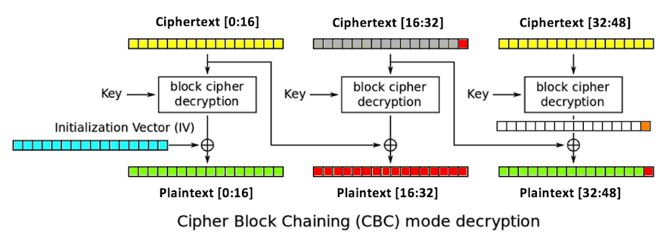
Padding Oracle

Slide 33
Detailed
0xB6
AES Decryption
0xB6 ^ 0xB2 = 0x04
0xB2
0x04

Slide 34
Detailed
0xB6 ^ 0x04 ^ 0x01
AES Decryption
0xB6 ^ 0xB2 = 0x04
0xB6 ^ 0xB2 ^ 0x01 ^ 0x04 = 0x01
0xB2
0x01

Slide 35
Padding Oracle Articles and other ressources
https://le4ker.me/tech/2017/05/29/padding-oracle-attack.html
https://robertheaton.com/2013/07/29/padding-oracle-attack/
https://erlend.oftedal.no/blog/poet/

Slide 36
Challenge #4

Slide 37
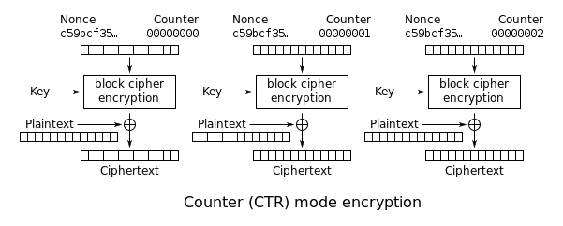
Counter-mode (CTR)
No padding
Block swapping resistance
Parallizable
Adds a Nonce and counter

Slide 38
The Nonce
In CTR mode, the Nonce is the same thing as the IV. It must be unique for each plaintext to encrypt.
However, there are bits used in the Nonce that act as a counter (usually 32 bits). This counter increments on each block to encrypt and should never be used twice in the same nonce.
When not implemented properly, counter is too small and may encrypt two or more blocks for the same message which could break the cryptosystem.
A static nonce leads to the same problems as static IV vulnerability.

Slide 39
Module 0x4
Attacker Methodology

Slide 40
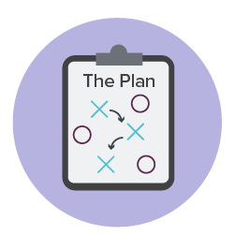
Topics
High-level view of methodology
Recon, Control
Identify, Exploit
Challenge !

Slide 41
Attack methodology
Recon
Control
Identify
Exploit
This is a proposed four-phase methodology to leverage successful exploitation of cryptosystem vulnerabilities.
Reconnaissance
Find information on target cryptosystem using out-of-band information.
Control
Find a user-controllable input that will be leverage to validate assumptions and ease exploitation.
Identify
The cryptosystem primitive, mode of operation and any other parameters must be identified to leverage exploitation.
Exploit
With all information in hand from previous phases, it is time to leverage one or multiple attacks on the cryptosystem for profit.

Slide 42
Recon
Source code
Application documentation
Forum discussions and troubleshooting platforms
Google
Control
Inject short and long data in each input
Identify when new blocks are created or removed
Stay aware of unexpected behaviors, exceptions and error messages

Slide 43
Identify
Block size
Mode of operation
IV or nonce presence
Exploit
Apply proper threat model on application considering cryptosystem vulnerabilities.
Select proper exploits to achieve goal.
Profit!

Slide 44
Challenge #5

Slide 45
Conclusion

Slide 46

Additional Ressources
Martin Lemay,
https://cryptopals.com/
https://www.coursera.org/learn/crypto
CISM, CRISC, CISA, OSEE
Chief Security Officer at Devolutions
mlemay@devolutions.net
Philippe Dugré,
B.Ing., OSCP
Application Security Analyst at Devolutions
pdugre@devolutions.net

Slide 47
Thank you !

